Slide 1
Notes for the animateur
This workshop is designed to work both online and in person. The workshop focuses upon retrofit by telling the participants a story about three characters who are experiencing the retrofit process. Throughout the story, the characters have different reactions and questions to the retrofit process. Workshop participants have an opportunity to relate to or disagree with certain characters. The core aim is to help participants understand elements of the retrofit process and for the facilitator to engage in conversations about the process.
Key points for the animateur:
Read through the story slowly, allowing participants to interrupt with any thoughts.
Spend around 10 minutes on each 'key questions' slide, creating space for participants to explore their thoughts.

Slide 2


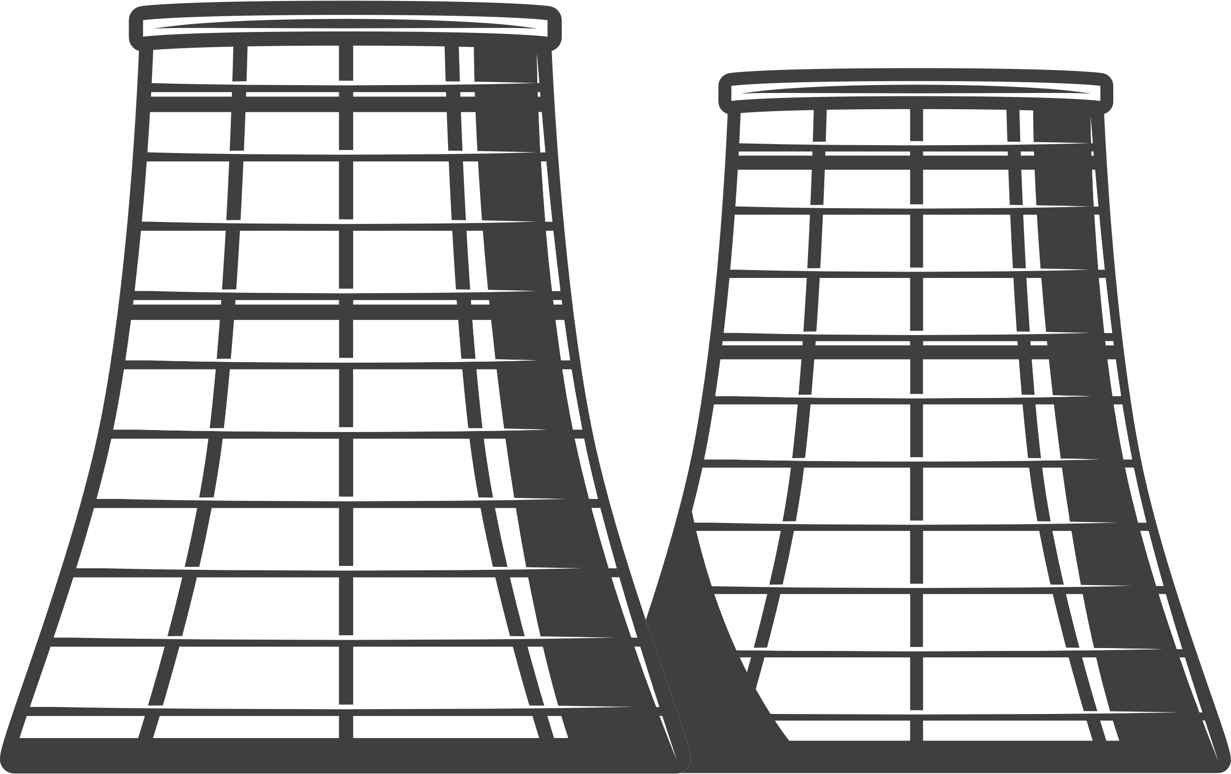
How Could Home Improvements and Energy Technology Reduce my Energy Bills?
Smart Home Energy Improvements Workshop
Zero
Carbon
Rugeley

Slide 3
The aim of this workshop...
  We would like to hear your thoughts on the possible approaches to addressing energy production and use in the home - these 'home improvements' are a major part of a ‘Smart Local Energy System’.
  We also want to answer any questions and generate discussion around 'smart home energy improvements'.

Slide 4
First of all …
What words come to mind when you hear the word ‘Retrofit’?
Notes:
Maybe follow up with a What does ‘retrofit’ mean to you?

Slide 5
And next …
What words come to mind when you hear ‘Smart Home Energy System’?
Notes:
Maybe follow up with a 'what does 'smart home energy system' mean to you?

Slide 6



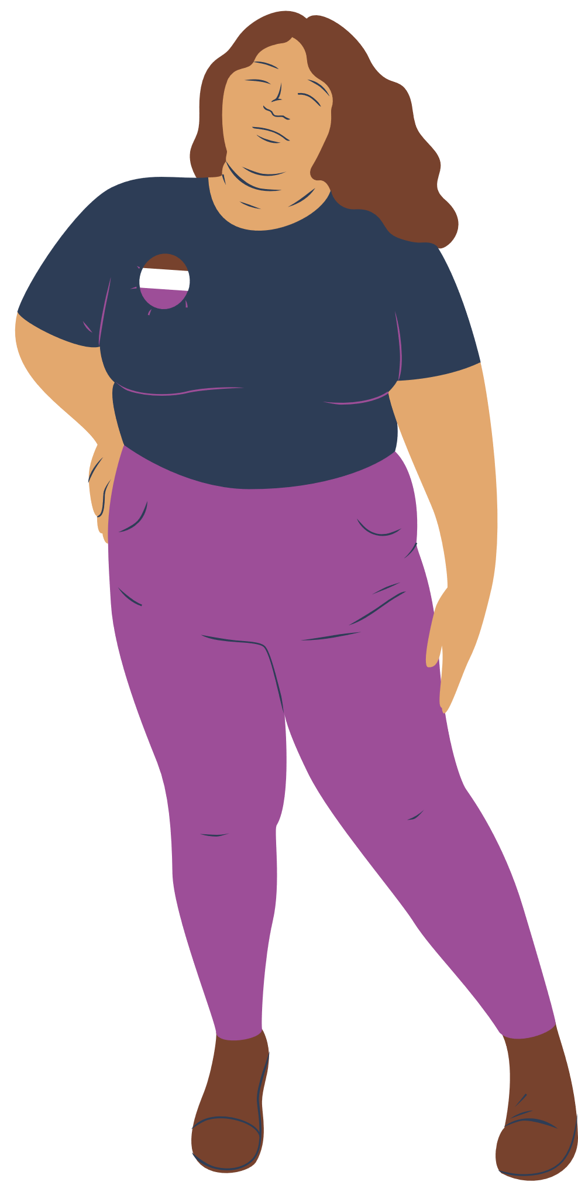
Meet the characters
David
Jill
Anna
You
Notes:
Explain session approach...

Slide 7
I am not interested in Smart Home Energy
I wouldn’t be against it
I want Smart technology installed in my home ASAP

Slide 8
The group, sign up to a 'Home Energy Improvement Programme' and their houses are inspected by trained professionals. Each member of the group (and you!) are given a document showing the improvements that could be made in their home. Improvements could include:
1) ‘Fabric’ side, i.e. insulation, double glazing, and draft proofing.
2) Energy technology to produce and store energy e.g. solar panels/batteries.
3) A home energy management system, including energy monitoring and smart controls.
Anna
David
Jill
David and Jill understand the ‘fabric’ and ‘ energy technology’ but are both unsure about the energy management system.
Anna is very interested in the energy management system

Slide 9

Key Questions
How long do you think the process would take to improve the ‘fabric’ of your home, install energy technology, and energy controls? Is this disruption acceptable?
What are your initial reactions to the home energy management system and smart controls?
Which person do you relate more to and why?

Slide 10
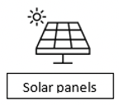
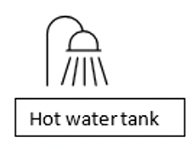
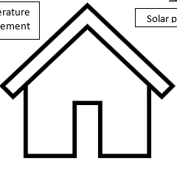
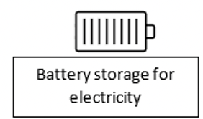

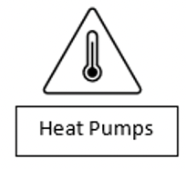
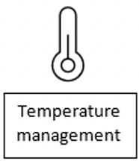
Home Energy Management
Energy Technology
Smart Energy Controls
Energy Generation
Energy Storage
Heating
  Water Control
  Light Control
  Heating Control
  Appliance Control
Light Controls

Slide 11
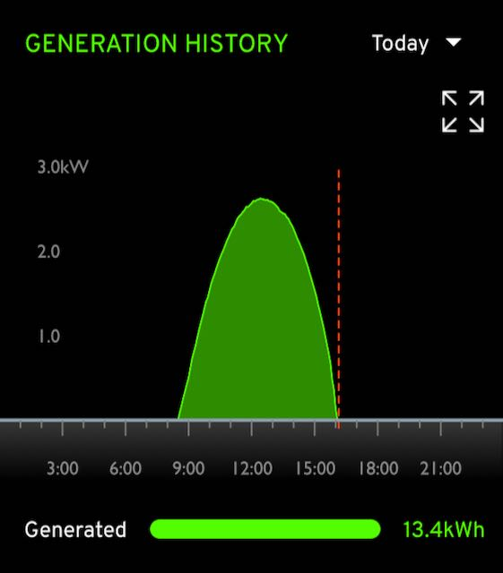
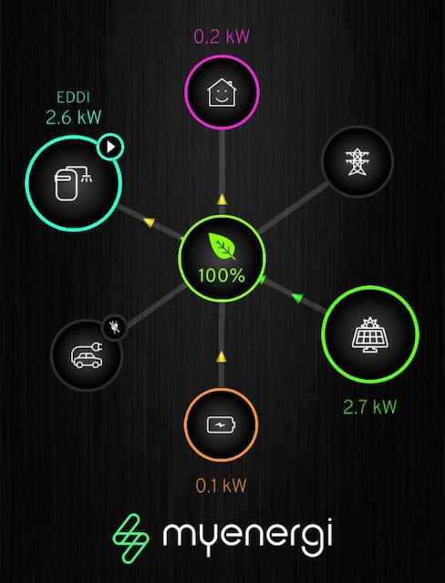
Energy Generation
Smart Controls

Slide 12
Anna
Monitoring
Anna explains that monitoring energy use in the home makes you more aware of your usage and helps to reduce the amount of energy wasted!
David
David is more convinced by the benefits of smart controls.
Through monitoring, smart controls could adapt the way that energy is used in the home to match behaviors. It knows this from the data it collects about energy use (similar to how your smartphone can track your steps or sleep!). For example, the system would see that David showers between 6 am and 7 am every day. It could ensure that the boiler is ready for this time and that the energy to power it had been bought at the cheapest time.
Jill
Jill is still unsure about the controls and would like to know more.

Slide 13
Key Questions
What do you think about the smart controls now?
Jill
"I am unsure about the smart controls"
Who do you relate with more?
How do you feel about data on your energy usage being collected and monitored?

Slide 14
I am not interested in Smart Home Energy
I wouldn’t be against it
I want Smart technology installed in my home ASAP

Slide 15
Jill
Levels of Control
After doing some research, Jill explains that the smart monitoring has different levels of control, ranging from 1 to 4.
Level 1 control only monitors the energy use in the home and can be manually turned on and off. Level 4 control uses the data to remotely switch appliances on and off/up or down. For example, it could turn your heating and lights off when you are not home. Or turn your dishwasher on at times when energy is cheapest.
David learns that the levels can be adjusted at any time to suit his preferences. This makes David even more comfortable with smart controls.
David

Slide 16
Key Questions
How comfortable would you be with the different levels of smart control?
What do you think levels 2 and 3 of the smart controls would do?
Is there anything else in your home that you would, or wouldn’t, want to be controlled?

Slide 17

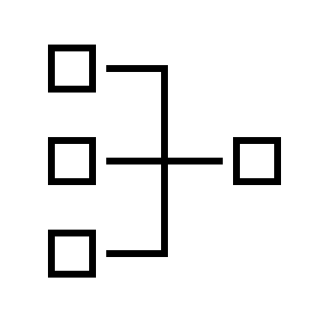
The group learn that their house can be linked to a larger control centre in Rugeley. This connects multiple houses at once, meaning that energy could be bought from the grid, or from a locally produced source such as solar panels on a neighbour's roof.
Anna
David, who owns an electric vehicle, but does not have solar panels, learns that the control centre would look at either A) the cost of buying energy from the grid, or B) the amount of locally produced energy available. It would charge David's vehicle using the cheapest energy available and have it fully charged for when he leaves for work in the morning.
David
David
Jill

Slide 18
Key Questions
How do you feel about the presence of the control centre in Rugeley? Would you feel comfortable allowing the centre to control the type of energy used (local vs grid)?
How would you feel about the system making sure his electric vehicle is charged up when he needs it using the cheapest electricity possible?

Slide 19
The costs for the whole process can be paid upfront, or the costs can be paid from the energy savings that would occur as part of a contract. The group learn that if more of their neighbours sign up to have improvements done at the same time, it would be cheaper for everyone.
Jill decides that the 'Smart' aspect is not for her, but is interested in a fabric retrofit.
David decides to talk to neighbours about signing up together.
Anna can afford to pay upfront and signs up.
David
Anna
Jill

Slide 20
Key Questions
Do you think you would be able to talk to your neighbours about signing up to a home energy improvement programme?
Who do you relate to the most (if anyone)? How convinced or interested are you in this process?
Do any of the improvements discussed seem more important than others?

Slide 21
I am not interested in Smart Home Energy
I wouldn’t be against it
I want Smart technology installed in my home ASAP

